Slide 1
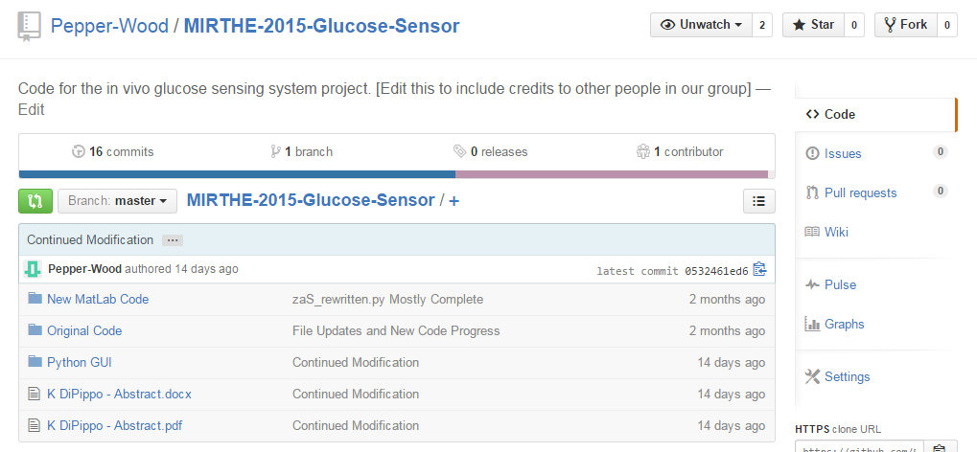
To see the complete updated code, please visit the below link and copy the code files that are uploaded there:
https://github.com/Pepper-Wood/MIRTHE-2015-Glucose-Sensor
GUI FILES in here. The latest versions of CLINICAL.py and SOLUTIONS.py are what we use

Slide 2
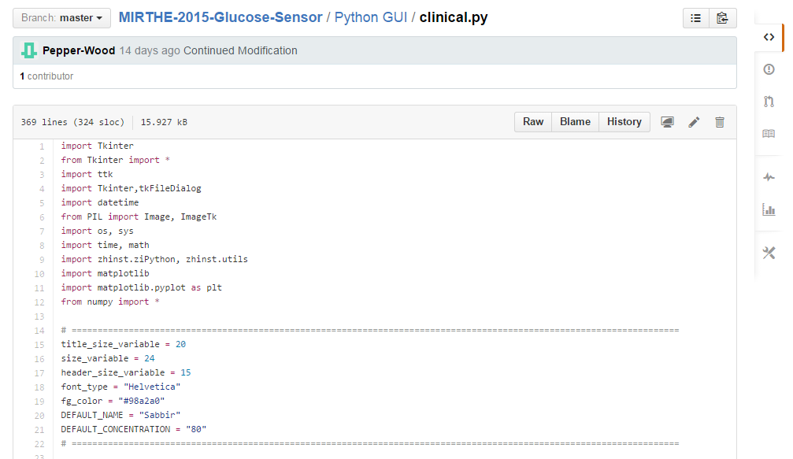
First, a look at how clinical.py works. This is the view you’ll see on the github.
These are all the python libraries we use.
Tkinter, ttk, tkFileDialog are all used for making the GUI itself.
Datetime is used to generate today’s date
PIL is used for making the GUI’s background image
Os,sys are used for generating folders to store data
Time,math are used to time how long the program runs for debugging purposes.
Zhist.ziPython communicates with the Zurich Instruments sytem
Matplotlib and Numpy are used to graph data we get from the Lock-In
These are basic variables placed here to be easily editted
Title_size_variable, size_variable, header_size_variable change the font and dialog box sizes of the GUI. Change these int values to see how things are affected
Font_type and fg_color change appearance of boxes. Fg_color’s hex code translates to a gray color.
DEFAULT_NAME and DEFAULT_CONCENTRATION are set here in the event that an entry is left blank in the GUI and resorts to these values instead of sending an error.

